Slide 1
Doing good with Good Busy Tools for the business case about the benefits and impact of employee volunteering
Version 3: July 2024
purpose

Slide 2
purpose
Make your own business case
It’s great that you want to start with employee volunteering and that you and your colleagues want to make a greater social impact. Enclosed you will find the ingredients to help you make your business case.
A business case shows whether a project contributes positively to the business objectives at an acceptable risk. In other words, whether the return on investment is higher than the investment you put in.
Good Busy supports you in creating support and making choices when setting up impactful employee volunteering programmes by supplying studies, facts and figures, and other practical tools.
The information in this business case can be freely used by anyone who wants to bring employee volunteering to a higher level.
If you use or publish information from this business case, please remember to cite sources.
And if you like to add something, please let us know via goodbusy@nov.nl. By doing so, you will also help other companies to be ‘Good Busy’.
Good luck and, above all, have fun creating a greater social impact!
Team Good Busy

Slide 3
Contents
Introduction: Make your own purpose case
What do you need to get started?
Definitions & Making impact
Balance between purpose and profit
The many facets of volunteering
Reasons for employee volunteering
Employee volunteering in figures
Employee volunteering effective for vitality
Volunteering and SMEs
Volunteering as part of the HR journey
Volunteering and SROI
Employee volunteering and SDG’s, ESG and CSRD legislation
Good Busy helps

Slide 4
What do you need to get started?
To start an employee volunteering programme you need the following basic ingredients:
An important first step is, of course, intrinsic motivation
Management commitment
Consider recruiting staff with an affinity for coordination and communication
And specify an initial budget for partnerships and projects
In the toolkit on social impact you will find the 5 principles for employee volunteering programmes with an impact.
Notes:
Principle 1: Balance between company strategy and employee passion
Principle 2: Shape effective partnerships
Principle 3: Recognize the many positive facets of volunteering
Principle 4: Volunteering as an essential part of HR
Principle 5: Embed volunteering policy in your organisational culture

Slide 5
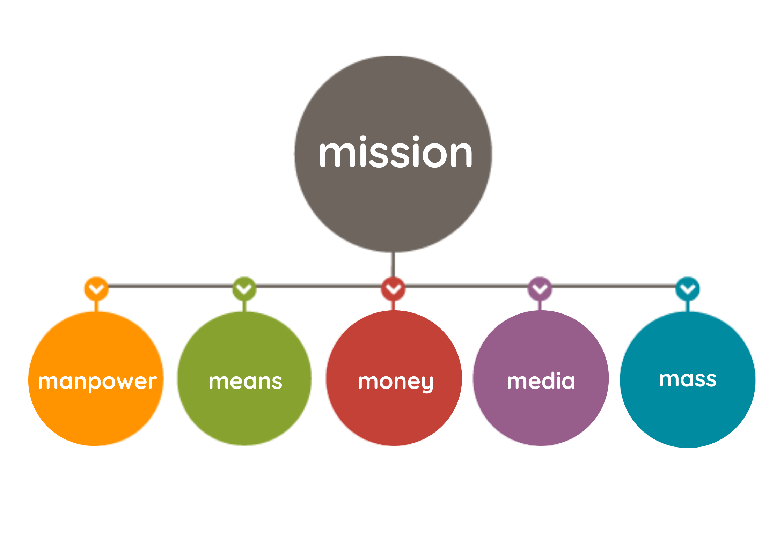
Definitions
What is employee volunteering?
Voluntary contributions made by your employees is also known as employee volunteering or corporate volunteering.
Employees of a company make time and knowledge available to social enterprises, non-profit organisations or charities.
By contributing to one-off activities or making long-term connections they can strengthen together - local - communities and create social impact.
What is CCI?
Employee volunteering is a form of Corporate Community Involvement (CCI)
There are various ways to shape your CCI as a company. You can contribute to society by sharing resources such as manpower, means, money and expertise.
This philosophy is based on the 5M model.
Source: Good Busy Toolkit for social impact
Notes:
5M model:
Mission:
Manpower
Means
Money
Media
Mass

Slide 6
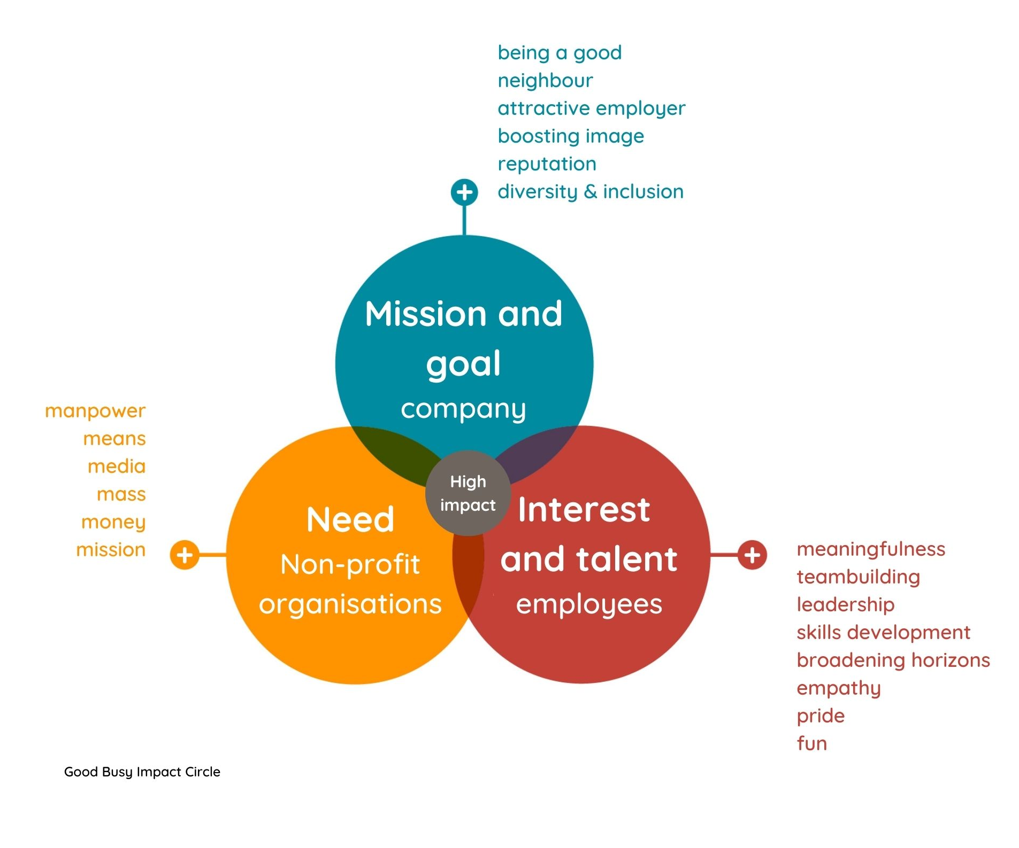
Making an impact
A company and a non-profit organisation can both benefit from a partnership and make a huge impact by working together.
The Good Busy impact circle visualises where the interests of parties meet and at that point the impact is the highest.
Notes:
Good Busy Impact circle
Oranje cirkel: Blauwe cirkel: Bruine cirkel:
Need Mission and goal Interest and talent
Non-profit organisations company employees
Oranje tekstgedeelte: Blauwe tekstgedeelte: Bruine tekstgedeelte:
Manpower Being a good neighbour meaningfulness
Means Attractive employer teambuilding
Media Boosting image leadership
Mass Reputation skills development
Money Diversity & Inclusion broadening horizons
Mission empathy
pride
fun

Slide 7
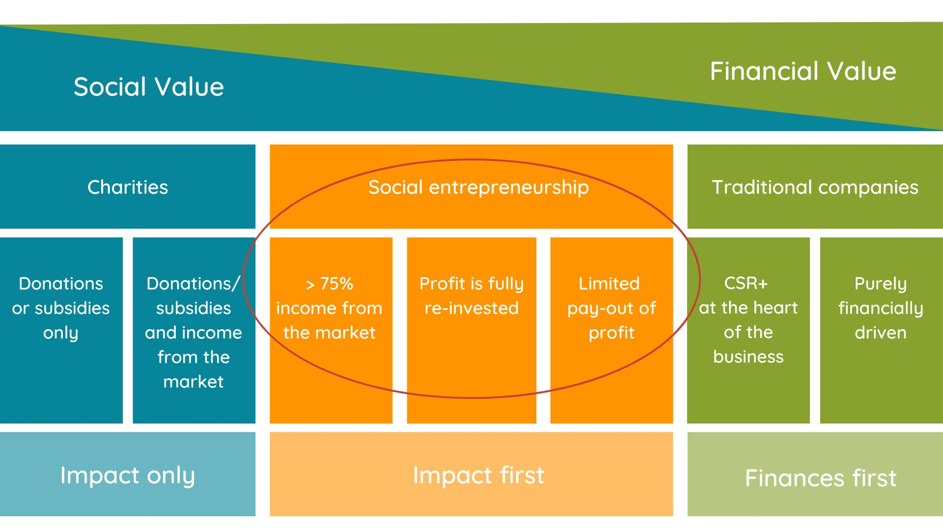
Balance between purpose and profit
Bron: Social Enterprise
Notes:
Zie apart Word-document

Slide 8
The many facets of volunteering
Are you a hands-on volunteering type who likes to do a social activity, perform a simple job or work in nature? Or do you prefer to share your skills and use your expertise to strengthen non-profit organisations and help them reach their goals and target groups? Both ways are possible with volunteering. The diagram below lists several examples in which an employee can support an organisation.
Needs social organisation | Support of a goal/target group | Strengthen organisations | Strategic development
Offer of a company | Hands-on volunteering Social activity with a target group Simple job activity/small project activity Working in nature Support paths Buddy, coach, mentor, etc. | Skill-based volunteering Pro bono expertise, amongst others in the field of: marketing & communication strategy & policy legal matters IT finance HR | Board activities Strategic advice
Source: Good Busy Toolkit on social impact

Slide 9
Reasons for employee volunteering
Good Neighbor As a company you want to make an important contribution to society
Attractive employer Employee satisfaction and engagement Attracting and retaining talent Team building and collaboration Personal and professional development Read more in the Good Busy HR whitepapers
Contribute to a more positive labor market and corporate image Growing trend: Dutch people consider doing good for people, society and the environment to be more important than ever. More than half of Dutch consumers want companies to show how they take their social responsibility and communicate transparently about their goals.*
Legislation Voluntary commitment can contribute to CSRD, ESG, SDG regulations and the Social Return task
*Source: Geven in Nederland 2024 and MIM research

Slide 10
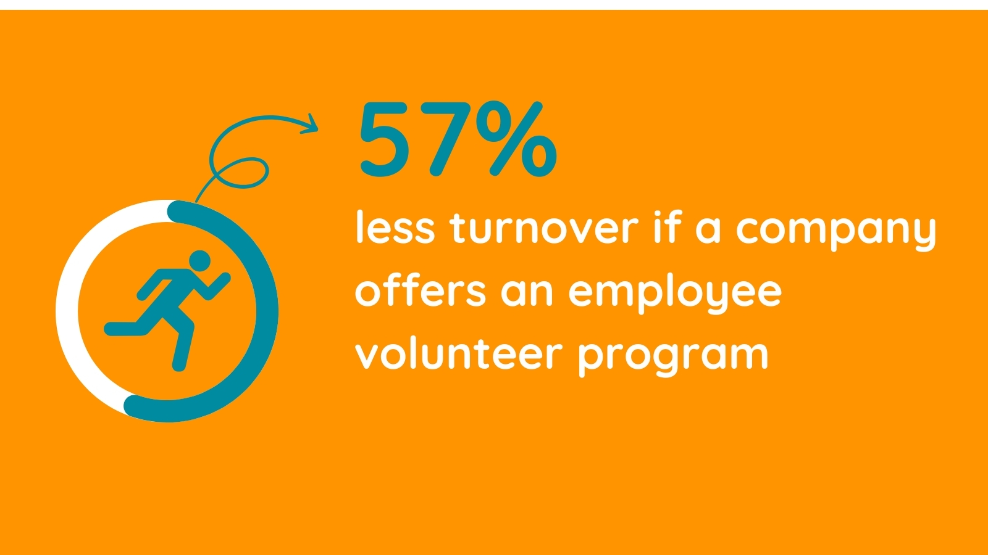
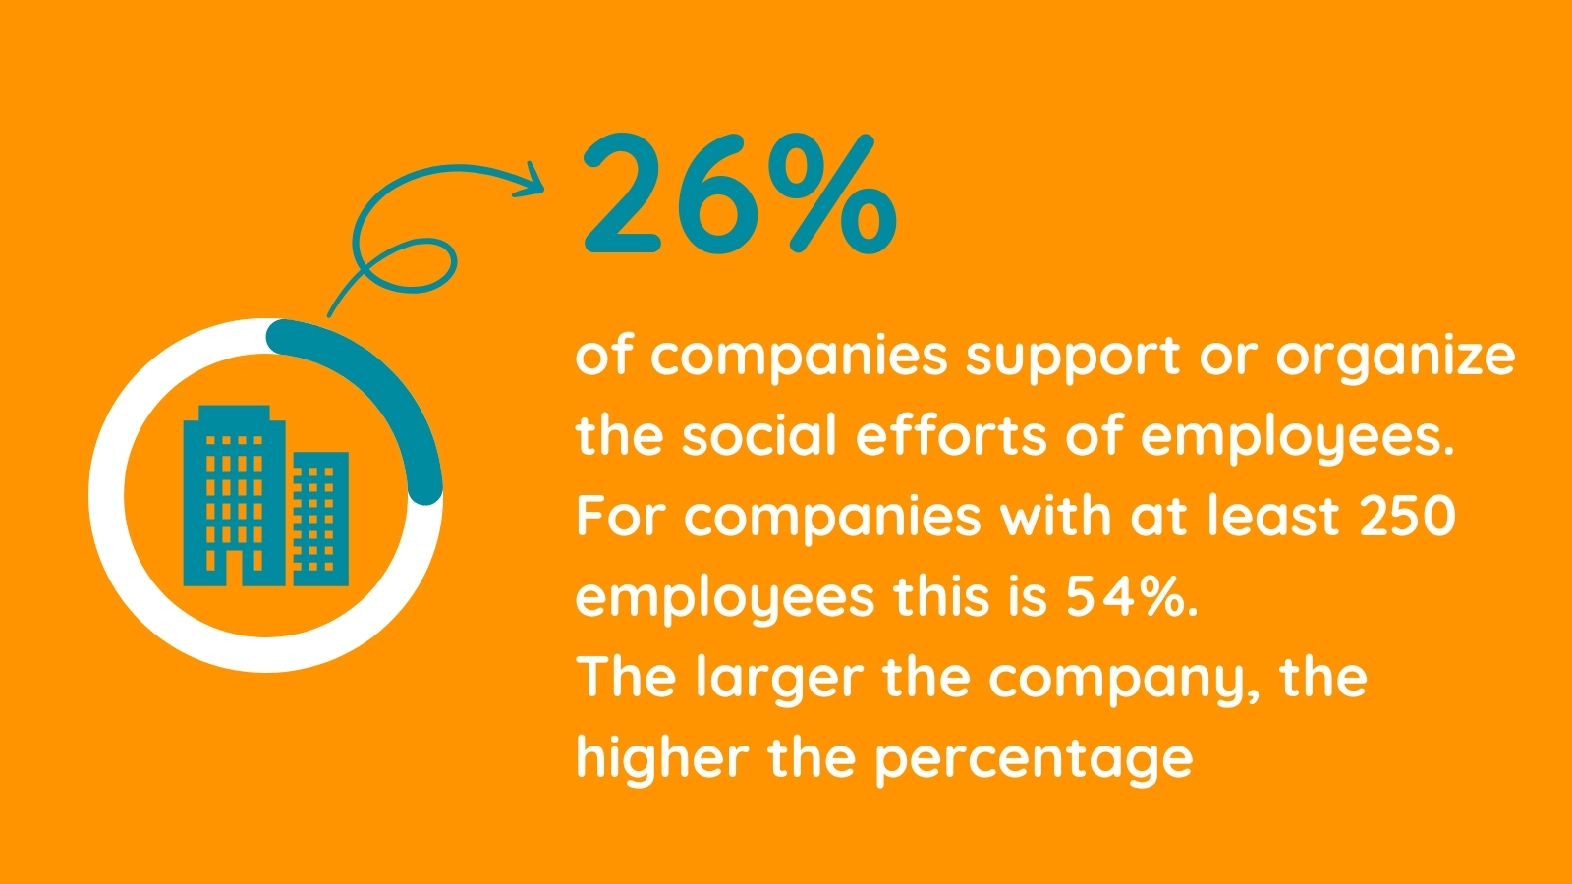
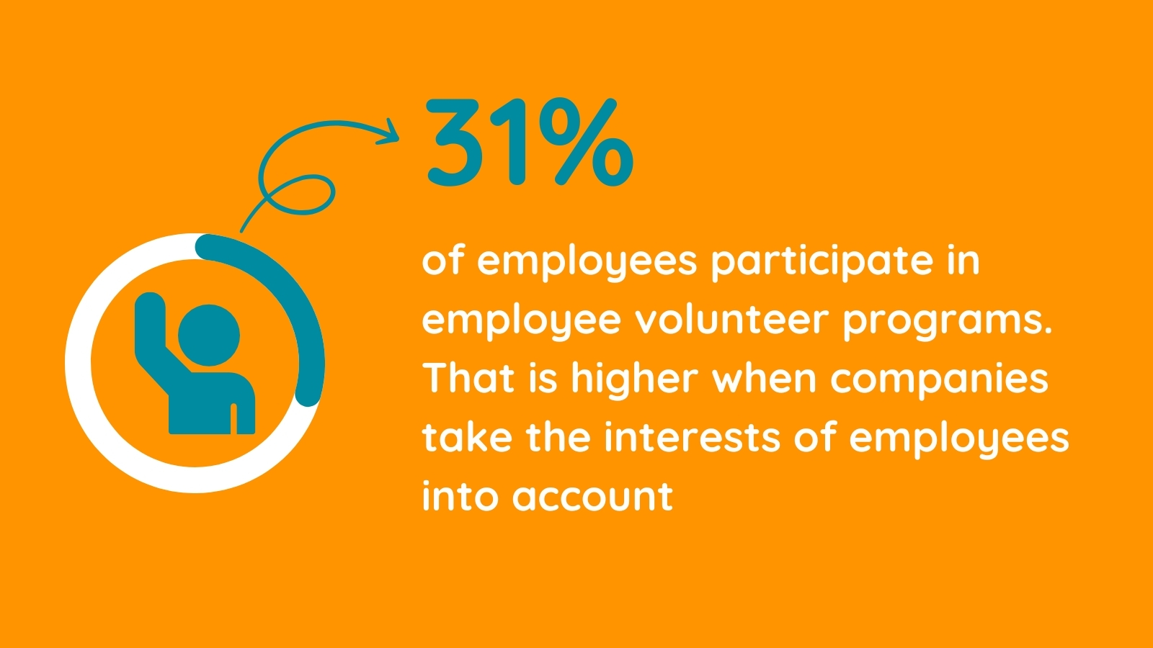
Employee volunteering in figures (1)
Source: UnitedHealthGroup - Doing good is good for you
Source: Geven in Nederland onderzoek 2024
Source: Geven in Nederland onderzoek 2024
Source: Geven in Nederland onderzoek 2024

Slide 11
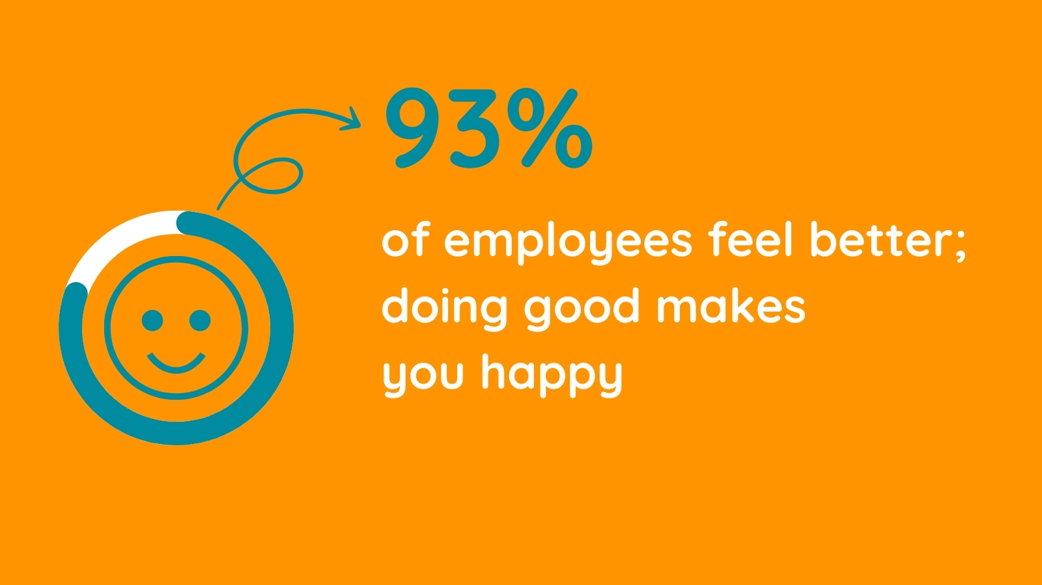
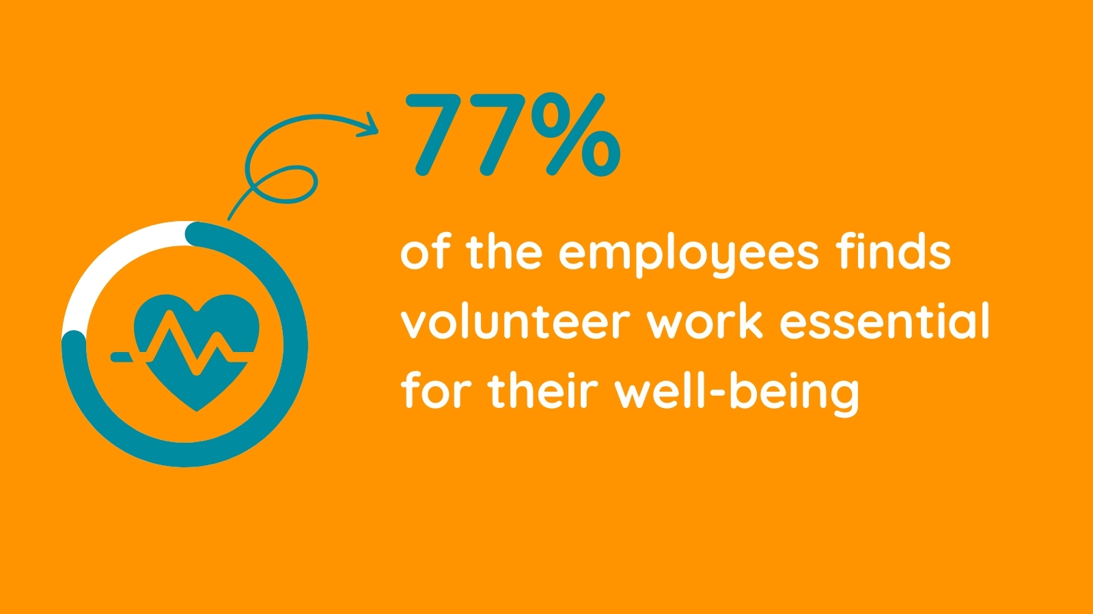
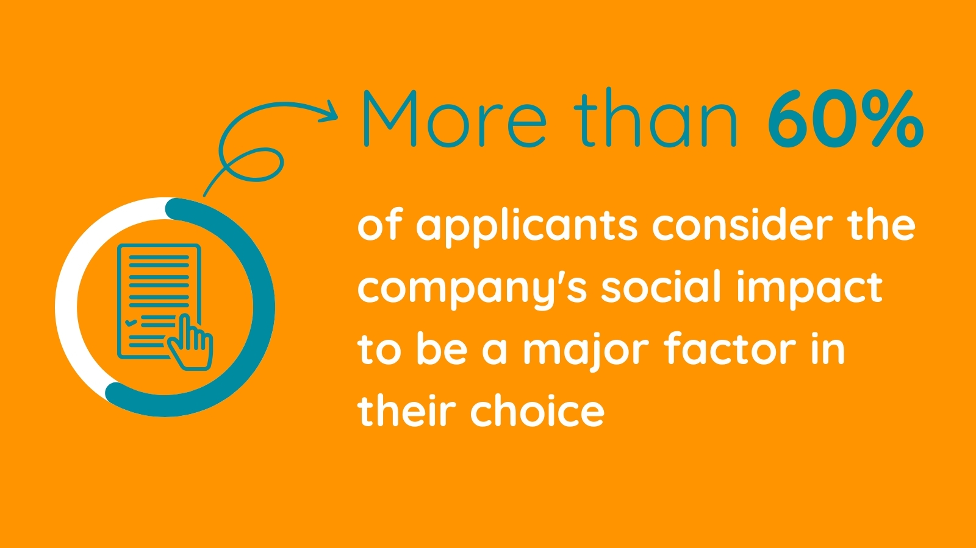
Employee volunteering in figures (2)
Source: Volunteermatch: Doing good is good for you study
Source: Grant Thornton Impact Onderzoek
Source: Deloitte Volunteer Impact Survey
Source: De inspirerende 40 - 2023

Slide 12
Employee volunteering effective for vitality
Employee volunteering appears to be more effective for their vitality than offering stress-relieving services such as mindfulness or online coaching. Although the effect of volunteering on mental health may vary individually, many positive links have been identified. Examples of this are:
Sense of purpose: Working on a meaningful cause often provides a profound sense of purpose and satisfaction. This can help create a positive mindset and reduce feelings of emptiness.
Social connections: Volunteering offers the opportunity to meet new people and be part of a community with shared values. Social interaction is essential for well-being and can reduce feelings of loneliness
Stress reduction: Focusing on helping others can distract from personal stressors and concerns. Experiencing empathy and contributing to positive change can reduce stress levels.
Self-esteem: Self-esteem can increase by knowing that you are contributing to something bigger than yourself. Seeing concrete results from your efforts can have a positive effect on your self-image.
Skills development: Volunteering provides opportunities to learn new skills and improve existing ones. It stimulates intellectual challenges and can promote a sense of personal growth.
Long-term satisfaction: Volunteering may be associated with higher levels of overall life satisfaction. The feeling of contributing to the well-being of others contributes to a more fulfilled life.
Source: University of Oxford 2023 & Platform De Dikke Blauwe

Slide 13
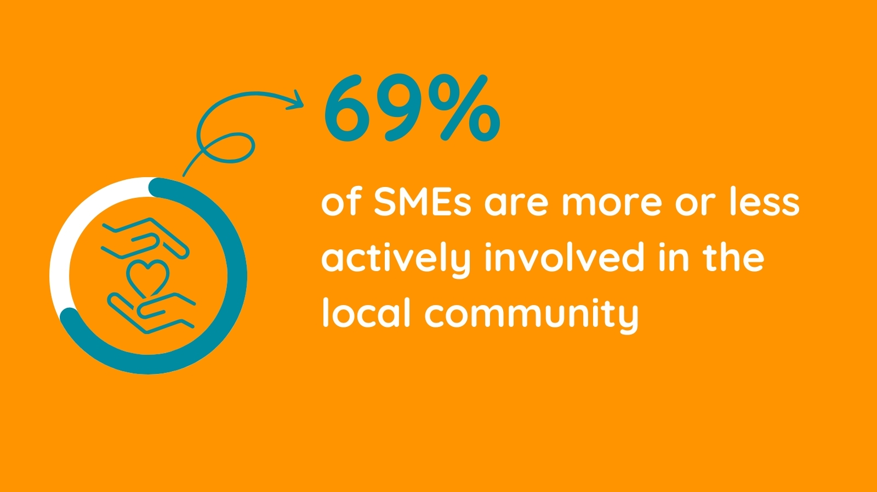
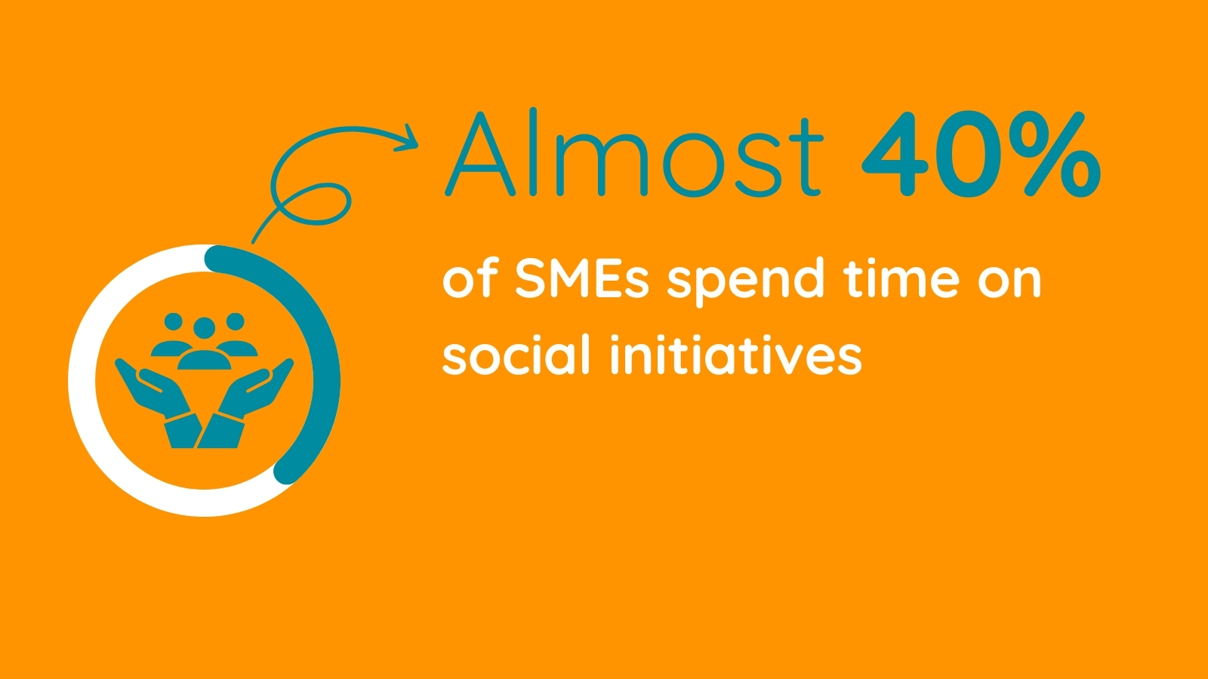
Volunteering and SMEs
Reasons to support social organizations and/or activities with time and money are:
(social) involvement, the connection or bond with the village/environment,
the quality of life of the village or region,
social obligation (social return) to give something back to society,
brand awareness and the regional labor market.
Source: De maatschappelijke waarde van het MKB – door Panteia & MKB Nederland

Slide 14
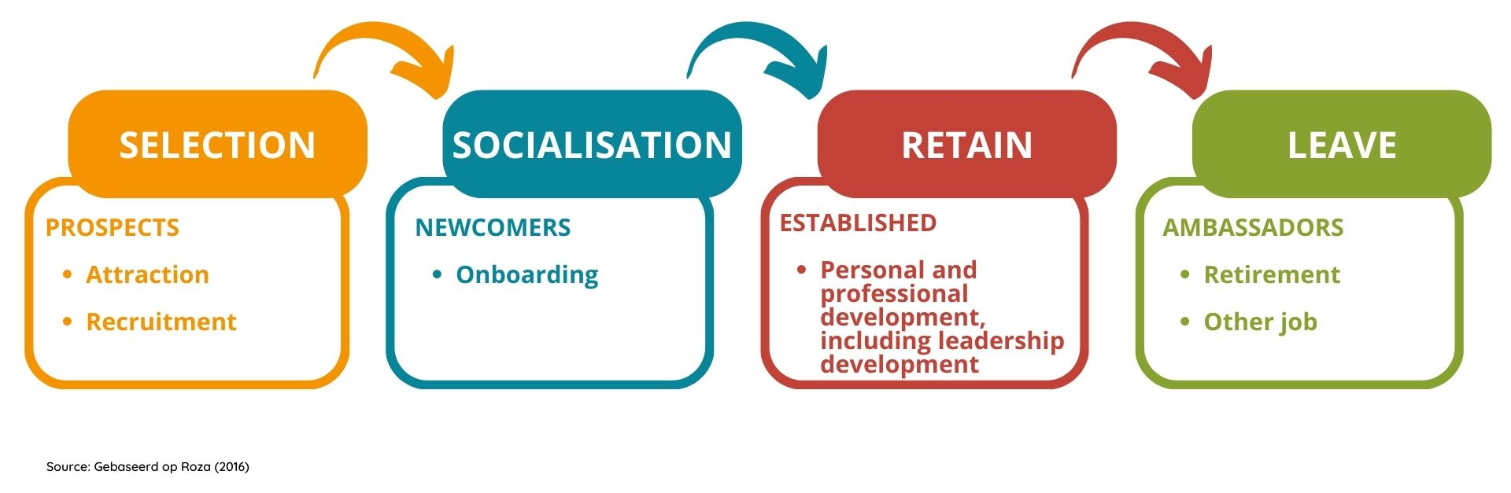
Volunteering as part of the HR journey
Employee volunteering contributes to attract, develop and retain employees. It is also a perfect tool to meet HR goals during the employee journey.
Notes:
Oranje: Blauw: Bruin: Groen:
SELECTION SOCIALISATION RETAIN LEAVE
PROSPECTS NEWCOMERS ESTABLISHED AMBASSADORS
Attraction Onboarding Personal and professional Retirement
Recruitment development, including Other job
leadership development

Slide 15
Volunteering and Social Return (SROI)
Employee volunteer work as an opportunity for social return
Social return was set up to encourage labor participation, but we increasingly see room for the 'social activities through employee volunteering' component within social return. What can this mean for your company?
Employee volunteering connects your company and your employees with social issues in our society. This experience contributes to greater understanding and inclusion.
It also connects colleagues in a different way and people like to work for a socially involved company.
Sometimes social return is not implemented or bought off because it cannot be achieved through labor participation, which leaves opportunities that can be achieved through employee volunteer work.
Read more about this topic.

Slide 16
Opportunities of SDGs
Sustainable Development Goals (SDGs) and voluntary efforts reinforce each other. Employees of companies can make a difference as volunteers by actively participating in activities aimed at promoting social, economic and environmental sustainability and thus contributing to various SDGs. read more

Slide 17
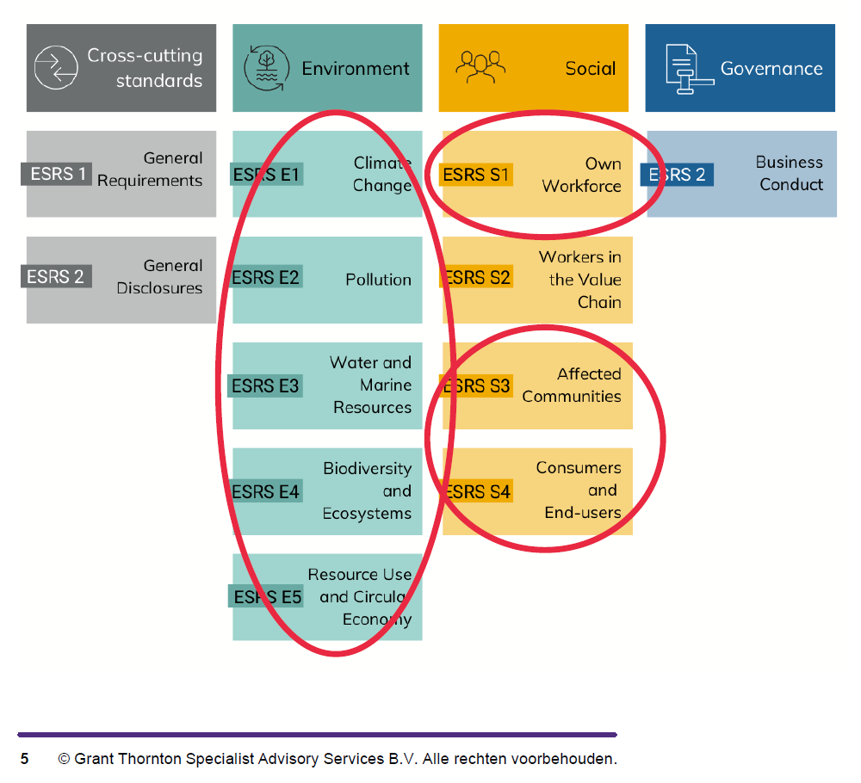
Volunteering and CSRD / ESG
The CSRD legislation obliges companies to report on their sustainable responsibilities, but also to report on social themes. And many companies have opportunities in the latter area, because they are also active in that area or would like to become active. Grant Thornton – Impact House looked for Good Busy to find out where exactly those opportunities are within CSRD. They logically see opportunities in the field of Social, but certainly also in Environment:
ESRS S1 -> Own workforce
ESRS S3 of S4 - > Affected communities & Consumers and End-users
ESRS E -> Environment
Read more about this topic.

Slide 18
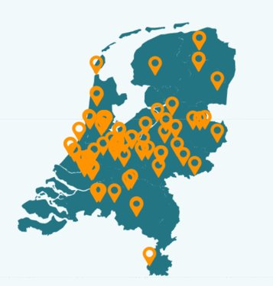
Good Busy helps
Visit www.goodbusy.nu
On our website you can find several toolkits and stories of entrepreneurs
Have a look in the Good Busy library
Subscribe to the Good Busy newsletter
Follow us on LinkedIn
Read our 'snackables’ about studies, tips and tricks, etc.
Visit the Help & Advice page on our website

Slide 19
Are you Good Busy?
www.goodbusy.nu
goodbusy@nov.nl

